Slide 1
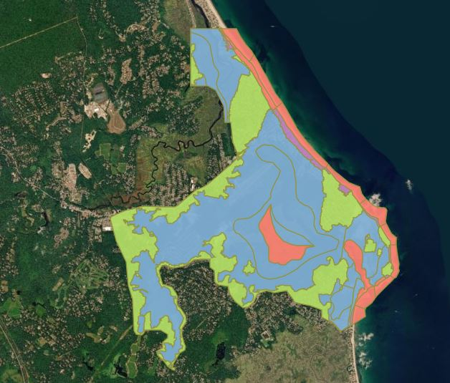
Marshfield Letter of Map Revision (LOMR)
Notes:
The affected area is colored in red, blue and green. It runs from Rexhame Beach south to the Duxbury Town line and from Station 8 in the downtown east along Route 139 to the ocean and along the Green Harbor River from the Duxbury Town line to the ocean.

Slide 2
What is a Letter of Map Revision (LOMR)?
A Letter of Map Revision (LOMR) is the Federal Emergency Management Agency’s (FEMA's) official modification to an effective Flood Insurance Rate Map (FIRM).
LOMRs can result in a physical change to the existing regulatory floodway, the effective Base Flood Elevations (BFEs), or the Special Flood Hazard Area (SFHA).
A LOMR does not require a Town Meeting vote.
Notes:
A LOMR is one way of modifying a Flood Insurance Rate Map. This LOMR changes both the Base Flood Elevation (decreasing for many homes and increasing for some homes) and changing the Special Flood Hazard Area (many homes coming out of the Floodplain and some homes coming into the Floodplain). A LOMR does not require a Town Meeting vote.

Slide 3
Marshfield LOMR
Because a LOMR officially revises the effective FIRM, the flood hazard updates shown are used to rate flood insurance policies and enforce flood insurance and development requirements.
On February 27, 2020 and March 5, 2020 the Public Notice for the Marshfield LOMR to the 2016 FEMA Flood maps was published in the Patriot Ledger.
This LOMR is part of the Towns of Marshfield’s and Duxbury’s efforts to improve the 2016 FEMA Flood Maps.

Slide 4
Marshfield LOMR Impacts
Staff has tried to identify the properties with a principal building (home or business) by street address, current (2016) and revised Base Flood information.
The Town does not make the official determination.
Under Federal law, the bank or lending institution are the ones responsible for making the official determination.

Slide 5
Marshfield LOMR Impacts
This LOMR will affect approximately 2,278 homes and businesses in Marshfield (within the storm surge influence of Massachusetts Bay).
632 Buildings will come out of the Flood plain,
1,476 Buildings will have their Base Flood Elevations (BFE) reduced by 4 to 7 feet in height,
37 Buildings will have no change,
106 Buildings will have their Base Flood Elevations (BFE) increased by 2 to 7 feet in height,
34 Buildings will come into the Flood plain (from X to an AO 3).

Slide 6
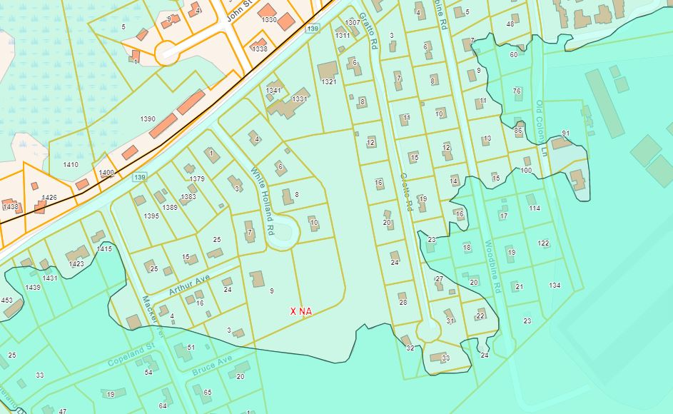
The LOMR removes the invisible wall along Route 139 (Ocean Street) where the north side had a Base Flood Elevation (BFE) of 9 feet and the south side of the road had a BFE of 14 feet.
Notes:
The lighter Teal color shows the area coming out of the flood zone.

Slide 7
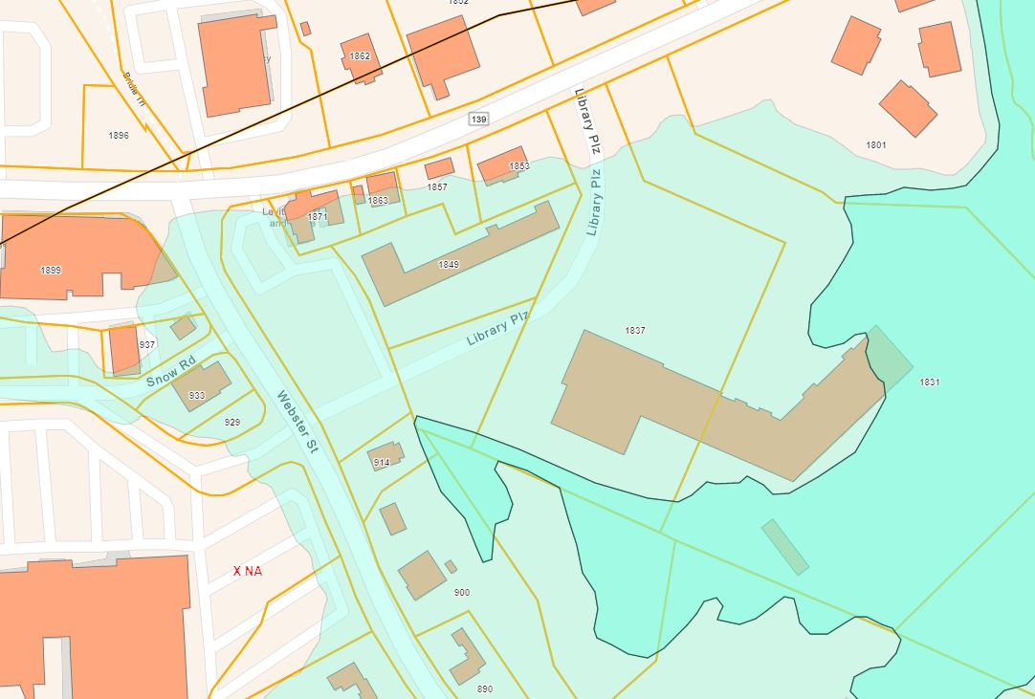
The LOMR will also remove most of the buildings in the downtown area including: Tumblefun, Station 8, Levitate and Dairy Queen.
Notes:
If you notice a part of the Road to Responsibility building is still in the Flood Plain. In this case (based on grade around the building) they may want to look into a LOMA to see if the building could come out completely.

Slide 8
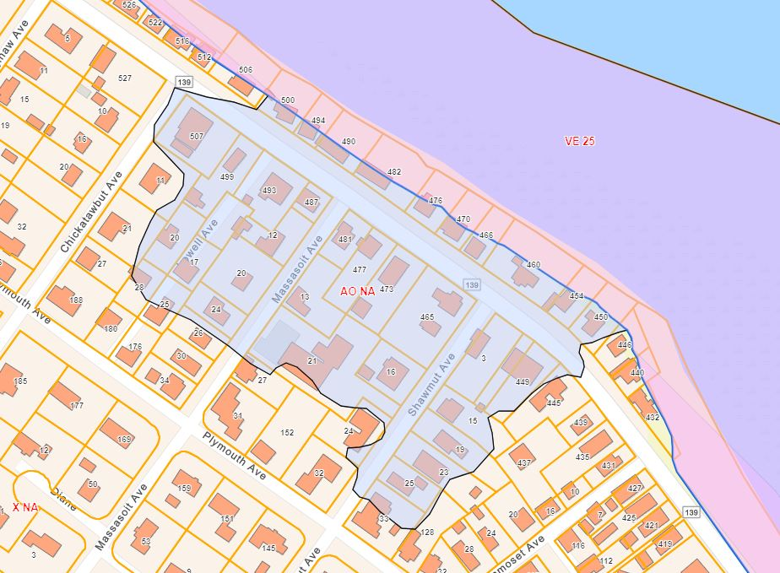
Unfortunately, due to the higher off shore wave conditions (VE 25 ) in the revised modeling and overtopping in that area, the LOMR does add a group of homes in the Lowell, Massasoit and Shawmut Avenue area into a AO 3 Flood zone.
Notes:
The area shown in light purple/blue shown on the map presently as AO NA is a AO 3 zone. Jim and Joe will provide more information about the AO 3 zone and newly mapped rates for insurance.

Slide 9
LOMR Time Frame
FEMA issued the Letter of Map Revision Determination Document on February 24, 2020. Unless appealed this LOMR will become effective on July 6, 2020.
No changes in flood zones and/or insurance rates are official until the LOMR effective date.
There is a 90 day appeal period to a LOMR. A request was sent to FEMA asking for the official deadline to the 90 day appeal period.

Slide 10
LOMR Time Frame
FEMA has not yet replied to the request.
If we use the issue date (2/24/20) the 90 day appeal period would end on May 26, 2020.
If we use the second notice in the Newspaper date of (3/5/20) the 90 day appeal period would end on June 5, 2020.
If you want to appeal this LOMR to be safe use the May 26th date.

Slide 11
LOMR Time Frame
An appeal of a LOMR requires supporting scientific and/or technical data. The criteria for data submittals can be found in Title 44, Chapter 1, Code of Federal Regulations, Section 67.6(b).
FEMA will review the alternative analyses and determine if the data in the appeal is superior to information supplied in the LOMR and whether any changes in the LOMR are warranted.

Slide 12
LOMA Changes after a LOMR
Individual properties may find that filing a Letter of Map Amendment (LOMA) after the LOMR is a better way to address an issue like still being in the flood zone because a corner of the house or wall just touches the flood zone.
An elevation certificates or certified plot plans are required by FEMA when filing a LOMA. More information about the LOMA process can be found at:
https://www.fema.gov/media-library-data/1490118979672-c9c3172e0cd7437cb033da371cf1751e/LOMA-LOMRF_Fact_Sheet.pdf

Slide 13
Flood Areas include the Following:
“AO” zones, shallow flooding exists without waves.
“A” zones, flooding with possible wave heights less than 3 feet.
“V” zones, where high velocity wave action and flooding exists, wave heights 3 feet or greater.

Slide 14
Establishing the design flood Elevation
The design elevation in “AO” zones shall be the elevation specified on the FIRM map plus one foot or 3 feet if no depth is specified.
The design elevation in “A” zones shall be the Base Flood Elevation (BFE) plus one foot.
The design elevation in a “V” zone shall be the BFE plus two feet.
Buildings and structures located in more than one flood hazard area and Coastal Dunes shall comply with the most restrictive provisions.

Slide 15
Building Permits
If you are either coming out of the Special Flood Hazard Area (SFHA) or going down in your Base Flood Elevation (BFE) you may use the new LOMR data with the understanding that the LOMR could be appealed and this appeal may delay or revert your BFE or SFHA back to the 2016 Map.
If you are coming in to the SHFA or going up in your BFE and already have your Building Permit you may proceed. If you do not have your building permit you will need to follow the new SFHA and BFE requirements.

Slide 16
Questions
For questions please contact:
Jim Folkard, Building Department jfolkard@townofmarshfield.org
Greg Guimond, Planning Department gguimond@townofmarshfield.org
Nanci Porreca, Zoning Board nporreca@townofmarshfield.org

