Slide 1
Fiscal Year 2022 Town Administrator Operational Budget Michael A. Maresco
APRIL 2021 TOWN MEETING FISCAL YEAR 2022
1

Slide 2
BUDGETARY ACHIEVEMENTS
OVERVIEW
We have accomplished a great deal with this Budget while we continue to combat
COVID-19
The FY 2022 Budget will provide $1,577,000 in new revenue for the School Department, a 3.0% increase overall
General Government has increased by 2.57% and we have built-in some new positions while repositioning resources to achieve this goal
We have added a full-time Nurse and a ¾ Nurse for The Board of Health
We have added a full -time Assistant Planner
We have added a full-time Assistant Conservation Agent
We have accounted for COLA’s and contracts in all divisions without use of Free Cash
We continue our cost share agreement with the schools for the Human Resources
Division
We continue to fund full time Building department staff
We have recommended an increase to public Safety of $357,182.38 over FY2021 to continue to provide the best resources for Police and Fire personnel
We have increased CTG Ball Field accounts by appx $100,000 and have provided DPW with department flexibility to move overtime cost around their various divisions
We have not reduced any senior or veteran services
We have managed to keep all municipal full time positions funded at this time, even during increased state charges and reductions to local receipts
2

Slide 3
REVENUES EXPLANATION
Revenues are again being recommended at a 2.9% overall increase
which we feel is achievable.
The Board of Selectmen had previously adopted a Budget Policy on
6-1-20 that no revenues should exceed 3%.
The revenue recommendation before you accomplishes that directive
Our other revenues were maintained at a 1.65% increase due to the reduction of our local receipts across the board.
Our State Aid figures remain close to a 1.2% over all increase
Debt Exclusions increased $114,241 to be raised by taxation outside of prop 2.5 ( debt exclusion passed 11-19-20 )
TOTAL REVENUE PROJECTION $103,174,582
3

Slide 4
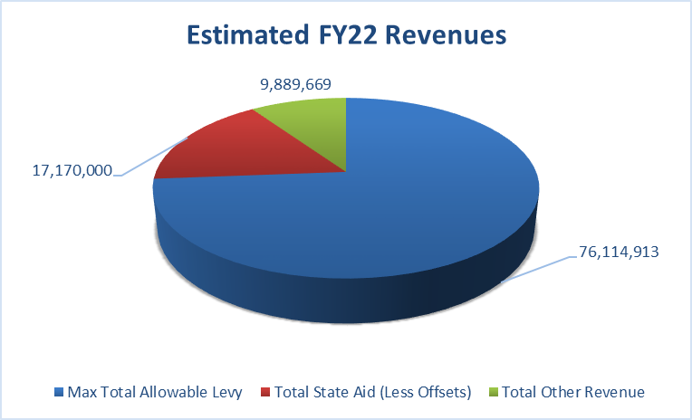
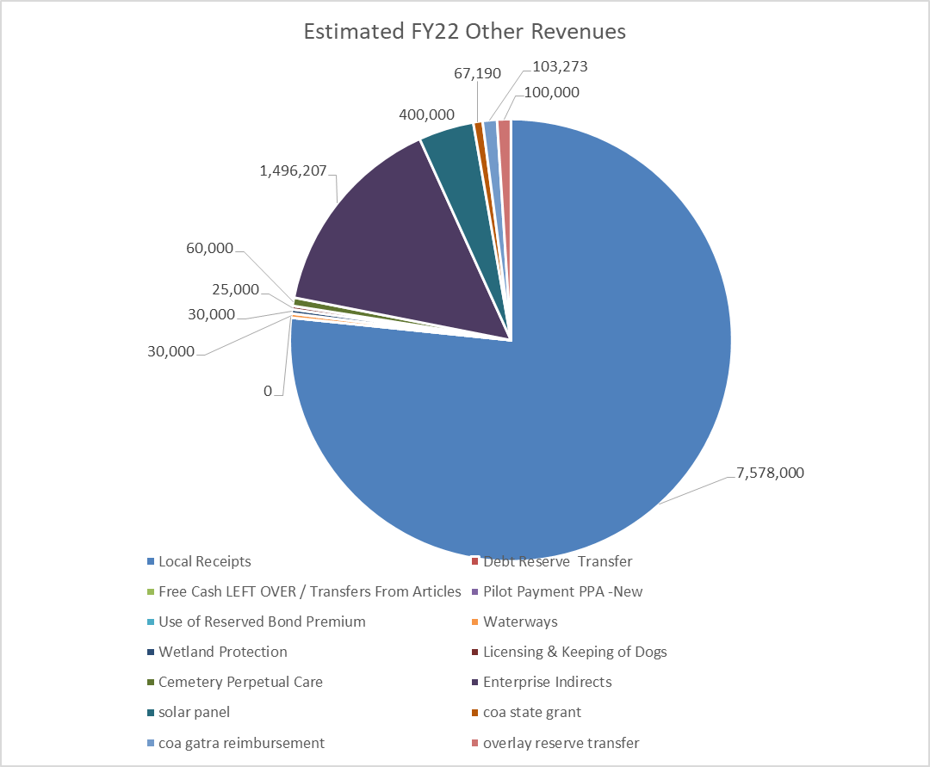
REVENUES
The charts in the slide identify total revenues on the right hand side and break out by type our other revenues to fund our municipal budget. Revenues increased 2.9% overall or
$3,031,756
4

Slide 5
EXPENSE EXPLANATION
The Town’s Department Heads have put in requests only for what is truly needed to keep providing services to our great community during this challenging time
The Centralized Budget process we now have allows The Town Administrator and Board of Selectmen to have the flexibility to reposition resources based on the needs presented during the budget hearings.
We have met with all departments twice and reviewed their requests to achieve their goals. We have again, not had to implement any layoff’s or furloughs as many of our neighbors have,thanks In large part to the support and recommendations of the Board of Selectmen
The proceeding charts and department reviews will provide further information
FY 2022 TOTAL EXPENSE PROJECTION $103,174,582
5

Slide 6
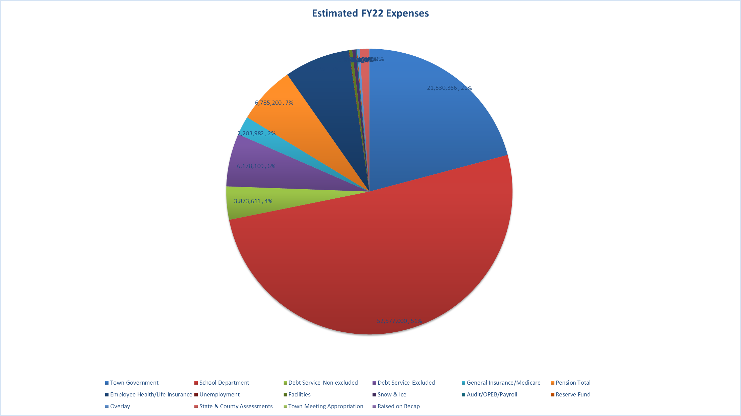
EXPENSES
6

Slide 7
FIXED COSTS
SUMMARY FY 2021
The Fixed Costs continue to be managed in accordance with our operational structure. This year was challenging given we had a $170,000 or 15% state assessment increase for charter schools.
The Finance Department, once again, was able to time the Debt Service structure to offset those increases and more, which saved the Budget
$333,583 this Fiscal Year.
This prevented layoffs and maintained a total fixed cost increase 0f less than 1% over last years increase. It is always our objective to keep Fixed Costs level funded
Total Fixed Cost Projected Increase of
$856,798 OR 2.95%
7

Slide 8
DEBT MANAGEMENT
Capital funds appropriated by borrowing or any other financing source may not be used for operational expenditures at any capacity. The Town makes certain these funds are kept separate and only used for the project in which it has been appropriated for by Town Meeting
The Finance Team with guidance from the Board has a policy that does not allow Inside Debt Costs to exceed 5% of our operating budget in total as well as Excluded Debt cannot exceed 10% of our operating budget in total. We have achieved both of those goals.
In total Debt Service has been reduced by $378,035 all while bonding our capital projects (Debt Exclusion passed 11-19-20 for Police Station, DPW Facility, Senior Center addition, and Seawalls)
Our Debt Management and GOB market knowledge has saved jobs this year
This will minimize our Tax impact because of our strategy, it worked and we will see the benefits of our conservative plan now and going forward
8

Slide 9
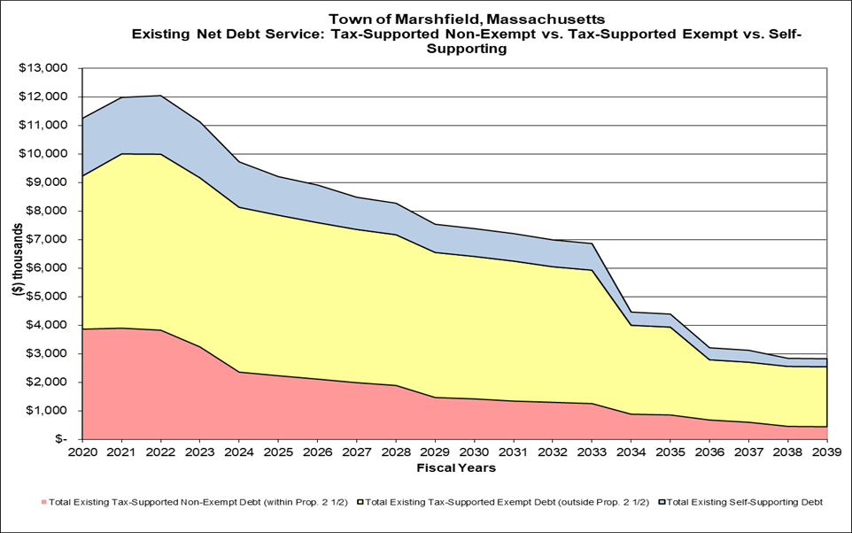
DEBT FY 2022 $ 10,051,720
Total Inside Debt $3,873,611…Total Excluded Debt $6,178,109
9

Slide 10
FY 2022 General Government
Total General Government Number is $2,909,196
The General Government was able to reposition resources to add a full-time Asst. Conservation Agent
The General government was able to fund a full-time Assistant
Planner by keeping an administrative clerk’s positon vacant for the time being as we manage costs through the Pandemic
The General Government has cut discretionary spending and IT costs due to the expected purchase of Munis
The General Government has built in 2% projected contractual
increases to the salary line items for Union and By-law employees
Total $2,909,196 or 2.57% increase

Slide 11
FY 2022 Public Safety
The Town continues to promote and provide funding for
its Public Safety Personnel
The Town settled contracts and increased public safety
by 2.75% in-line with recently signed CBA’s
The Police and Fire returned appx. 450K in FY 20 by exceptional management of overtime and resources.
The Police and Fire Departments continue to receive support from Capital Budget to purchase safety equipment, guns, ammo. and Tasers, ambulances, fire trucks and supplies
Public Safety Increase of $357,182 or 2.75%

Slide 12
FY 2022 Education
The Schools received a full 3% increase on it’s operational budget over FY 2021.
The School’s total Number is $52,577,000 or 3.00%
increase
The Schools have done a fantastic job of combating the COVID-19 viruses while educating our students
We have received Millions in support for the Schools from the Cares Act Funding
Town Meeting has supported SRO’s for the next three years
The School and Town have worked to improve WI-FI expansion for all School and Town facilities

Slide 13
FY 2022 Public Works
The Town Continues to support our Public Works Departments to provide the
best services to our citizens
The Public Works Division will see a 2% increase overall for potential
contractual increases
We have worked with the Superintendent of Public Works to reposition resources to provide additional funding for maintenance of the fleet
Most recently we have increased the Ball Field and Parks Account by
$100,000 to keep our fields and play spaces in the high quality shape our community deserves
The Public Works also receives support for their capital needs through the
Capital Budget Process
Total Commitment to General Fund Public Works $3,026,973

Slide 14
HEALTH AND HUMAN SERVICES FY 2022
We continue to fund a full-time Assistant Veterans Service agent
We have provided additional COA funding for goods and services for our senior population to continue thriving
We have increased funding for the Board of Health agents and have funded a full-time Nurse and a ¾ Nurse to keep the Town healthy during the COVID- 19 Pandemic
Total increase $114,897 or 8.4%

Slide 15
CULTURAL SERVICES
The Library has taken on the task to keep services open and allow the public to have access to Library Resources during the Pandemic
The Town continues to fund under cultural services clam flats, veteran memorials, and the historic
commissions effort’s
The cultural services benefit us all
Total Commitment to our Library and Cultural Services is $826,148

Slide 16
UTILITIES
The Town will be receiving additional energy credits with the most recent power purchase agreement as well as placing a solar array field on our capped landfill
We have invested, with green community grant funds, into LED lighting for school buildings and the Fire Station, Town Hall is coming up next!
The Utility Budget covers all Town building costs for heat, electricity, and communications
The current funding level is $402,588 and we hope this will be
decreased by energy credit offsets

Slide 17
REVENUE

Slide 18
EXPENSE

Slide 19
CLOSING SUMMARY
The FY2022 Budget as presented is balanced
The Tax rate went down to $13.19 per thousand
The Schools received a 3% increase of their FY21 Budget.
The School Resources Officers will continue to be funded by our grant (SRO’s at the MHS, FBMS and the Elementary)
The General Government Budget has increased by 2.5 %
The Town Hall elevator is up and running to create better access for our citizens who struggle with mobility issues.
We are funding full time nurse to the BOH and are funding a ¾’s position for another nurse.
We are funding a full-time Assistant Planner and Assistant Conservation Agent to manage the very large case load demands
We are funding colas and contracts without Free Cash usage.
We continue to cost share with the Schools for HR.
We have increased public safety funding by $357,182 for Fire and Police.
We have increased CTG Ball Field accounts by $100,000 and have provided DPW with flexibility to manage overtime costs.
No layoffs or furloughs
Capital projects are underway for the DPW ‘s new building and plans for the additional space, Senior Center expansion, the new Police Station and our seawalls. I am happy to report that to date we have saved the taxpayers $13.7 million dollars due to very valuable interest rates and the use of $1.2 million in bond premium funds for these projects to date.
We will continue to look for ways to reduce costs on these projects as we move forward.

Slide 20
FY 2022 Budget
THANK YOU !

