Slide 1
Fiscal Year 2025 Operational Budget Michael A. Maresco Town Administrator
APRIL 22, 2024 TOWN MEETING

Slide 2
BUDGETARY ACHIEVEMENTS OVERVIEW
The FY2025 Budget provides a recommended increase of $1,923,368 for the School Department, a 3.45% increase over FY2024.
Town Government has increased by 4.47% and we have maintained our work force, while repositioning resources to achieve this goal.
We have accounted for COLAs and contracts in all divisions without using free cash
We continue our cost share agreement with the Schools for the Human Resources Division
We have recommended an increase to Public Safety of $339,693 over FY2024 to continue to provide the best resources for the Police Department, Fire Department, and Ambulance Services for our residents.
We continue to fund CTG Ball Field accounts by approximately $100,000 and have provided DPW with department flexibility to move overtime cost around their various divisions
We have not reduced any senior or veteran services
We continue to keep all municipal full-time and part-time positions funded at this time, all while managing continual increases in our pension cost, healthcare contributions, utility costs, and gas and diesel fuel cost to run our town fleet.

Slide 3
REVENUES EXPLANATION
Revenues are being recommended at a 3.35% overall increase over FY24 Revenues.
Our State Aid figures is anticipated to be $18,657,095 or 2.5% increase over FY24’s aid.
TOTAL REVENUE PROJECTION for FY25 $115,404,910 an increase of $3,735,954 or 3.35%

Slide 4
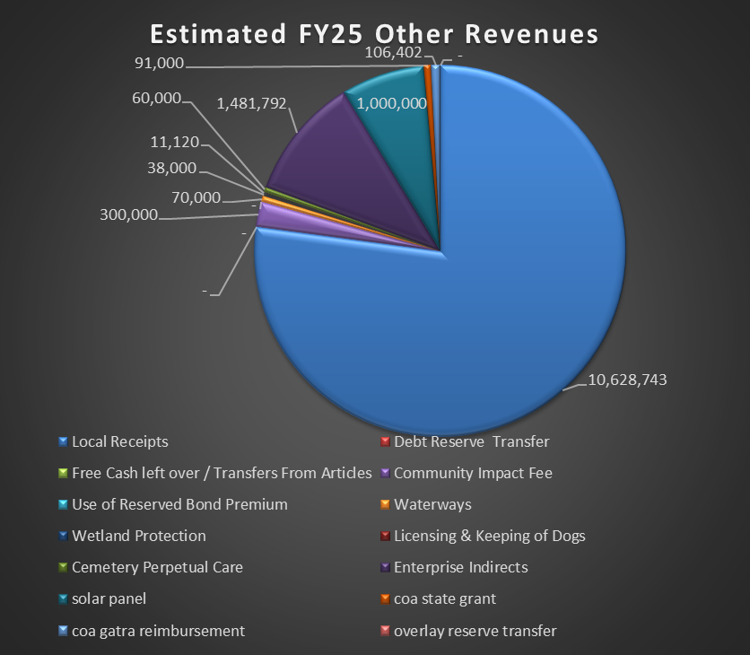
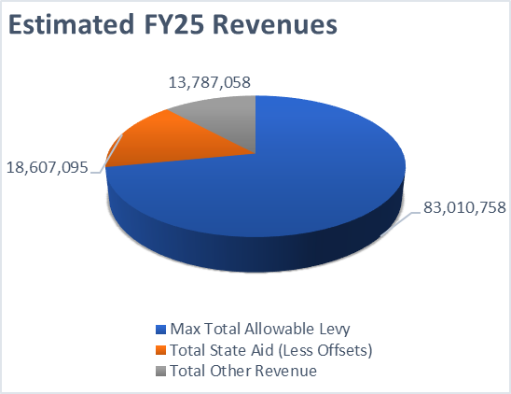
REVENUES
The charts on this slide identify total revenues on the right-hand side and break out by type our other revenues to fund our municipal budget. Revenues increased 3.35% overall or $3,735,954

Slide 5
EXPENSE EXPLANATION
The Town’s Department Heads have put in requests only for what is truly needed to keep providing services to our Town during these challenging times while dealing with rising inflation, utility costs, fuel costs, pension costs, and healthcare contributions.
The Centralized Budget process we now have allows the Town Administrator and Select Board to have the flexibility to reposition resources, based on the needs presented during the budget hearings.
The Town has overcome last year’s challenges with the hiring of a new Town Treasurer Collector Shaun Strobel and through the process there has been a wonderful collaboration between Department Heads and Staff!
The Treasurer Collector and I have met with all Department Heads and reviewed their financial requests needed to achieve the goals of the departments for our residents. We have again not had to implement any layoffs or furloughs, as many of our neighbors have, thanks to the support and recommendations of the Select Board.
The following charts and department reviews will provide additional information
TOTAL EXPENSE PROJECTION FOR FY25 of $115,404,910 an increase of $3,718,387 or 3.33%

Slide 6
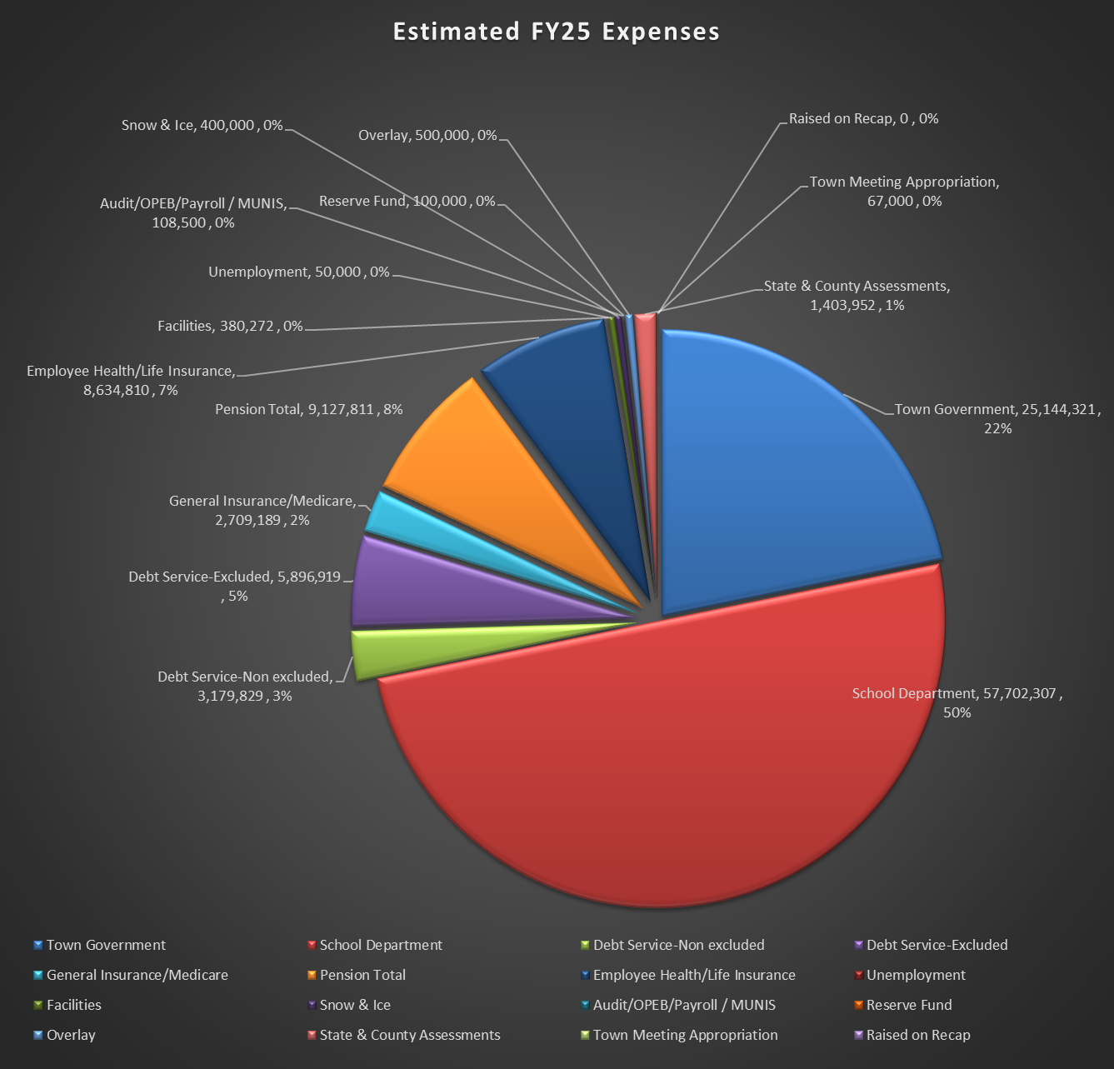
EXPENSES
6

Slide 7
FIXED COSTS SUMMARY FY 2025
FIXED COST EXPENSE | FY23 Actual | FY24 Appropriated | FY25 Request
DEBT SERVICE- NON EXCLUDED | 3,367,325 | 3,103,712 | 3,179,829
DEBT SERVICE - EXCLUDED | 6,017,958 | 5,868,297 | 5,896,919
GENERAL INSURANCE / MEDICARE | 2,156,968 | 2,300,116 | 2,709,189
PENSION TOTAL | 7,507,920 | 8,453,323 | 9,127,811
EMPLOYEE HEALTH/LIFE INSURANCE | 7,797,745 | 8,181,912 | 8,634,810
UNEMPLOYMENT | 0 | 50,000 | 50,000
FACILITIES | 394,648 | 1,019,235 | 380,272
AUDIT/OPEB/PAYROLL | 267,764 | 127,500 | 173,000
OTHER FIXED COST EXPENSE
RESERVE FUND | 100,000 | 100,000 | 100,000
OVERLAY | 300,000 | 300,000 | 500,000
STATE & COUNTY ASSESSEMENTS | 1,346,593 | 1,387,777 | 1,403,952
TOWN MEETING APPROPRIATION | 66,000 | 67,000 | 67,000
Total Fixed Cost Projected Increase over FY24 of $718,410 or 3.33%

Slide 8
DEBT MANAGEMENT
Capital funds appropriated by borrowing or any other financing source may not be used for operational expenditures in any capacity. The Town makes certain these funds are kept separate and only used for the project for which it was appropriated by Town Meeting
The Finance Team with guidance from the Board has a policy that does not allow Inside Debt Costs to exceed 5% of our operating budget in total, nor Excluded Debt to exceed 10% of our operating budget in total. We have achieved both of those goals
In total Debt Service has been reduced by $113,353.36 due to interest reduction because debt is being paid down all while bonding our capital projects (Debt Exclusion passed on 11-19-20 for Police Station, DPW Facility, Senior Center addition, and seawalls)
Because of our conservative plan of debt management and uniform annual payments, we have minimized our tax impact and will see the benefits of our conservative plan now and in the future.

Slide 9
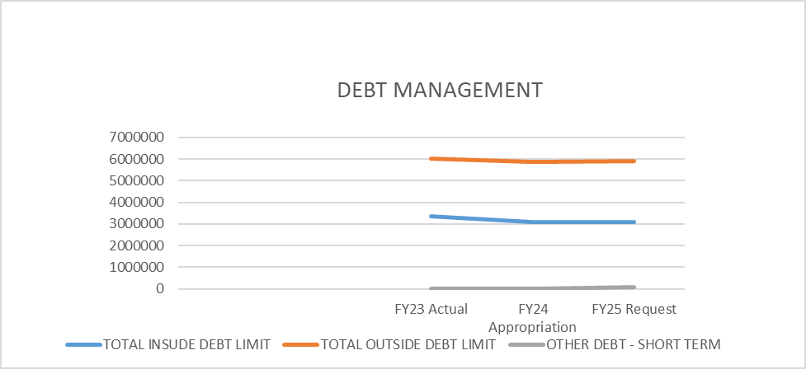
DEBT FY 2025 $8,976,748
Total Inside Debt $3,079,828
Total Excluded Debt $5,896,919

Slide 10
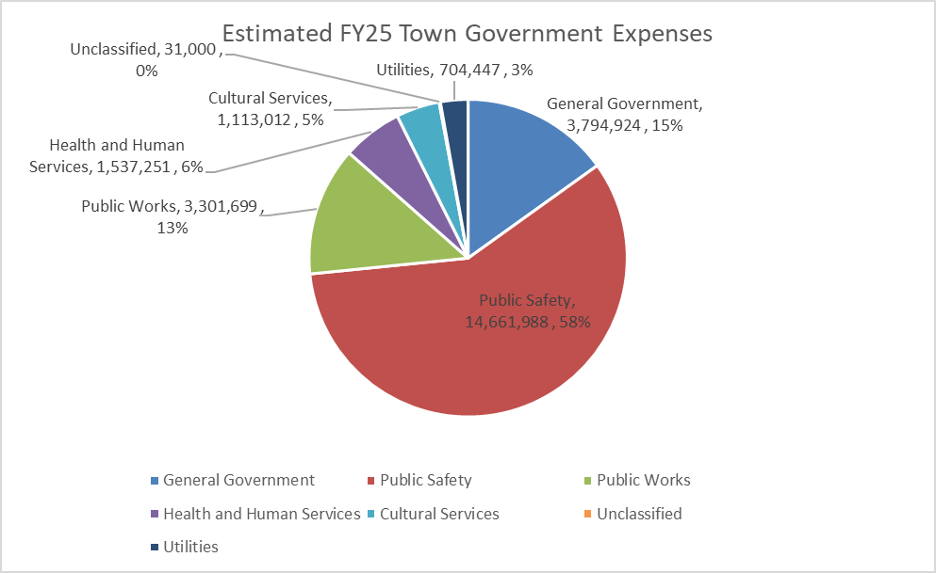
FY 2025 General Government
Total General Government Proposed Budget: $3,794.924
The General government:
Has reduced discretionary spending and IT costs due to the purchase of MUNIS
Built in a 2% projected contractual increases to the salary line items for Union and By-law employees
The Town began converting the financials to MUNIS on December 1, 2022. The conversion has had its challenges especially with being able to pull financial data in from our old software systems into MUNIS. This was the main reason for the delay in closing the FY23 books with the state. The full conversion to MUNIS won’t be completed until FY26.
Total $3,794,924 an increase of $387,312 or 11.37% over FY24

Slide 11
FY 2025 Public Safety
The Town continues to promote and provide funding for
its Public Safety Personnel including full funding for school resource officers at the High School, FBMS, and Elementary Schools.
The FY25 Budget increased public safety by 2.37%.
ARPA Funds have been allocated to purchase (2) ambulances and (1) fire truck.
The Fire Department will be utilizing a grant to purchase an Off-Road Fire Truck.
The Police and Fire Departments continue to receive support through the Capital Budget process to purchase safety equipment and police vehicles.
Public Safety Increase of $339,693 or 2.37%

Slide 12
FY 2025 Education
The School Department will receive a full 3.45% increase on their operational budget over FY 2024 for a total projected budget of $57,702,307, representing an increase of $1,923,368 over FY24.
The Schools have worked to improve handicapped accessibility and increased security for all Schools.
The School Department opened their new Pre-K facility at 255 Furnace Street in September.
Capital Budget funding and Free Cash have continued to assist the Schools in maintenance, IT, and security related issues.

Slide 13
FY 2025 Public Works
The Town continues to support our Public Works Departments to provide the best services to our citizens
The Public Works Division will see a 2.83% increase overall for FY25.We have worked with the Superintendent of Public Works to reposition resources to provide additional funding for maintenance of the fleet.
We continue to support and maintain the Ball Field and Parks Account keeping our fields and play spaces in the best possible shape that our community and sports teams deserve.
Public Works also receives support for their capital needs through the Capital Budget process for General Fund and through retained earnings for Wastewater, Water, and Solid Waste.
The Select Board provided DPW $4 million dollars of the County ARPA Funds for two (2) infrastructure projects: Surf Ave ($1.7 million) and Plymouth Ave Pump Station ($2.3 million)
Total Commitment to General Fund Public Works $3,301,699 an increase of $90,914 or 2.83%

Slide 14
HEALTH AND HUMAN SERVICES FY 2025
The Town has:
provided additional COA funding for goods and services allowing our senior population to be active in educational and social activities
created a revolving fund for the Seaflower Café at the Senior Center
increased funding for the Board of Health agents and continued to fund (1) part-time Nurse to keep the Town healthy during the aftermath of COVID and SRV.
Total Health and Human Services budget increased by $6,608.00 or 0.43%

Slide 15
CULTURAL SERVICES FY25
The Library has taken on the task of increasing services by opening on Sunday to allow greater access to Library Resources during the weekend including a book drop off and pickup program, public Wi-Fi, and many cultural programs for students and the general public.
The Library rug was replaced during the winter of FY23. A great improvement for our residents.
The Town continues to support our Library and fund other cultural services, including clam flats, veteran memorials, and the Historic Commissions efforts.
These cultural services benefit us all!
Total Commitment to our Library and Cultural Services is $1,113,012, an increase of $36,196 or 3.36% for FY25

Slide 16
UTILITIES
The Town of Marshfield is committed to going green with a very aggressive investment in PV, battery storage, charging stations, electric vehicles, LED lighting, and building enhancements
The Town will be receiving additional energy credits with the most recent power purchase agreement as well as placing a solar array field on our capped landfill, PV on Municipal Buildings and carports in parking lots including Schools, Police, COA and DPW. We will be adding electric charging stations at the Police, COA, and DPW facilities to eliminate a single point failure and battery storage to hold PV
The Town implemented Aggregate Electric with approval from Massachusetts Department of Public Utilities in FY23.
We have invested in LED lighting for school buildings and the fire station, boiler replacements at Central Fire, and FBMS with Green Community grant funding
The Utility budget covers all Town building costs for heat, electricity, and communications
The current funding level is $704,447, an increase of 215,886 or a 44.19% increase, with the expectation that this will be decreased by energy credit offsets.

Slide 17
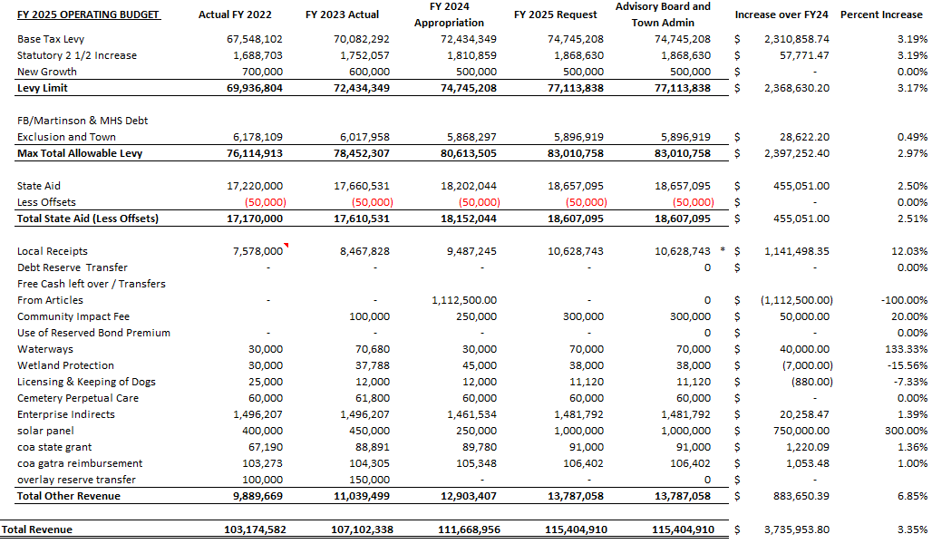
REVENUE

Slide 18
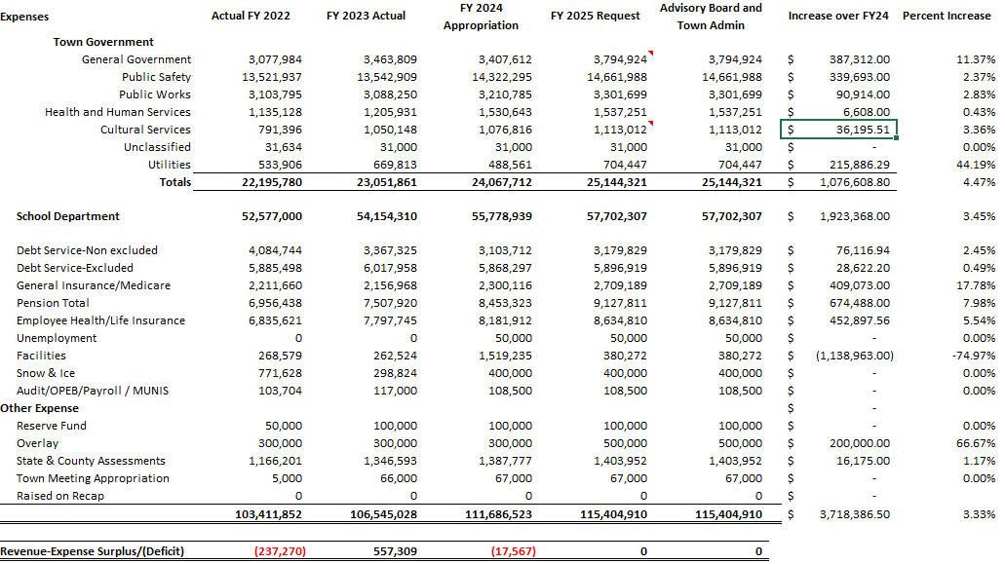
EXPENSE

Slide 19
CLOSING SUMMARY
The FY2025 Budget as presented is balanced
The tax rate was reduced to $10.39 per thousand
The Schools received a 3.45% increase of their FY25 Budget
The School Resources Officers will be funded through the General Fund (SROs at the MHS, FBMS and the elementary schools).
The General Government Budget has increased by 11.37%
The Town Hall elevator continues creating better access for our citizens who struggle with mobility issues along with our newly renovated bathrooms.
We continue to fund one part-time nurse for the Board of Health.
We are continuing to fund a full-time Assistant Planner and Assistant Conservation Agent to manage the very large case load demands of those departments.
We have funded COLAs and contracts without Free Cash usage.
We continue to cost share with the Schools for Human Resources
We have increased public safety funding by $339,693 for Fire and Police to ensure our residents are safe and secure.
We continue funding CTG Ball Field accounts and have provided the DPW with flexibility to manage overtime costs.
FY25 budget will fund Robert Egan who serves as the Town’s Weights and Measures Consultant responsible for making sure all scales in our town businesses are fair and accurate.

Slide 20
CLOSING SUMMARY
The new DPW building capital project is completed. The new Police Station capital project is completed, the Senior Center renovation/addition is completed and our seawalls; Brant Rock one and two have been completed with other section of Ocean Street in Brant Rock has been repaired.
Fire and Ambulance supplies will be funded by the General Fund.
We will continue to look for ways to reduce costs on these projects as we move forward
The DPW is investing in repairs and upgrades in our water and sewer infrastructure with $4 million in ARPA Funding being used on Surf Avenue (1.7 million) and the Plymouth Avenue Pump Station (2.3 million) that will get under way this Spring.
The Dog Park opened in June of 2023 and is being enjoyed by many of our four-legged friends thanks to the Stanton Foundation, the CPC Fund, Friends of the Marshfield Dog Park and the support of the Select Board.
Modernization of Town Hall is underway with six (6) new bathrooms, a new chamber, select board offices, TA’s Office and repositioning and upgrades to other offices including Veterans, Building, IT, Town Clerk just to name a few. These improvements were funded with no additional cost to Taxpayers by using the unspent capital funds from the Senior Center Project.
Finally, we continue to make up ground on the maintenance of our public buildings, thanks to the great work of our Facilities Department and the support by Town Meeting, for the funding from Free Cash

Slide 21
FY 2025 Budget
THANK YOU !

